Slide 1
SUMMER INTERNSHIP 2023
Project Report
Members:
Akshay Malik (202212008)
Lakshay Malik (202212051)
Project Title : Faculty Appointment System

Slide 2
Introduction
The Faculty Schedule Appointment System by students based on MERN Stack is a web application that empowers students to schedule appointments with their faculty members in an organized and efficient manner. This system aims to facilitate seamless communication between students and faculty, allowing students to seek guidance, discuss academic matters, and resolve queries effectively.
Key Features:
Student Authentication
Faculty Profile
Faculty Profile
Real-Time Notifications

Slide 3
Appointment Management
User Dashboard
Privacy and Security
Technology Stack
Front-end: React.js will be used to build the user interface, providing a smooth and responsive experience for students.
Back-end: Node.js and Express.js will handle server-side logic and API development.
Database: MongoDB will store and manage the application's data efficiently.
User Authentication: Implement JSON Web Tokens (JWT) for secure and reliable student authentication.

Slide 4
Real-Time Notifications: Socket.io can be utilized to enable real-time communication and instant notifications.
State Management: Redux or React Context API will manage the application's state and data flow.
Benefits:
Efficient Communication
Time-Saving
Improved Faculty-Student Interaction
Flexibility

Slide 5
Functional and Non-Functional Requirements
Functional Requirements
User Registration and Authentication
Faculty Profile Management
Appointment Scheduling
Real-Time Notifications
Appointment Management
User Dashboard

Slide 6
Non-Functional Requirements
Security
Performance
Scalability
User Interface (UI) and User Experience (UX):
Availability
Compatibility
Data Integrity
Error Handling and Logging
Data Privacy and Compliance

Slide 7
Methodology/Process
A new User have to Login or Existing User Have to register.
After Sign in User Can see the Various Faculty With their Specialization and their Appointment Timing.
If user is a Faculty Then he/she can Apply for Faculty From the Dashboard Menu APPLY FOR FACULTY
After Applying then Admin Got the Notification , and he accept or reject the request After Verification.
If he accepted as a faculty from admin side, then the faculty can update his profile anytime and Students can Apply for appointment to this faculty.
Faculty can also see what appointment he/she receive and according he/she can choose to accept or reject as per availability.
User request for Appointment to faculties as per the timings.

Slide 8
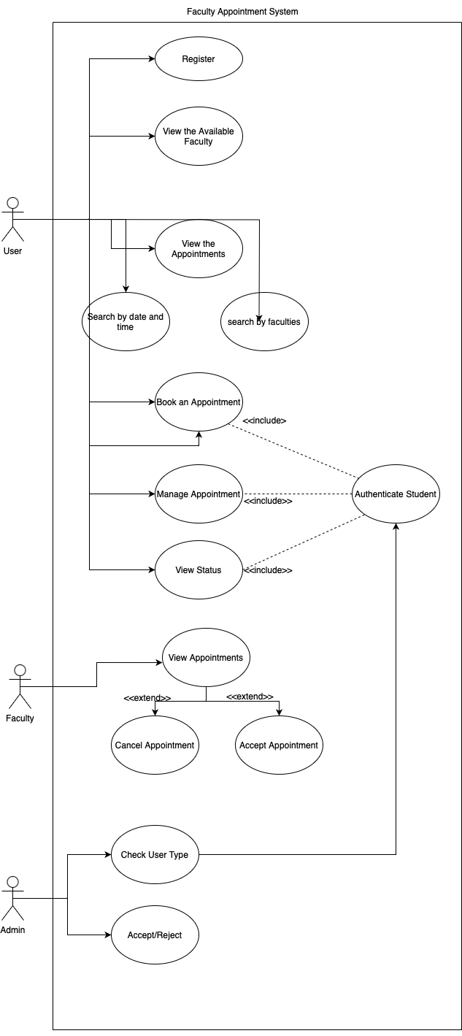
Design (Use Case Diagram.)

Slide 9
Testing
Testing is a crucial part of the software development process to ensure that the Faculty Schedule Appointment System based on the MERN (MongoDB, Express.js, React.js, Node.js) stack functions correctly and meets the desired requirements. We will discuss different types of testing and how to approach testing for the system.
Unit Testing:
Unit testing focuses on testing individual components and functions in isolation.
Integration Testing:
Integration testing verifies the interaction between different components or modules.

Slide 10
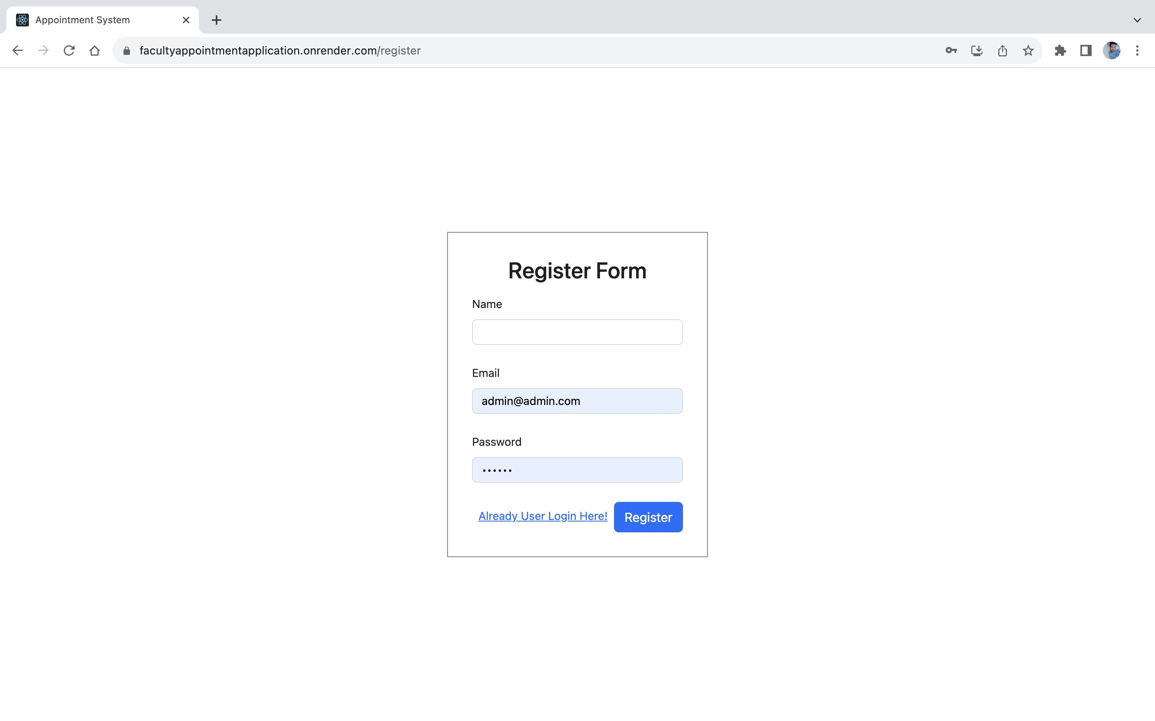
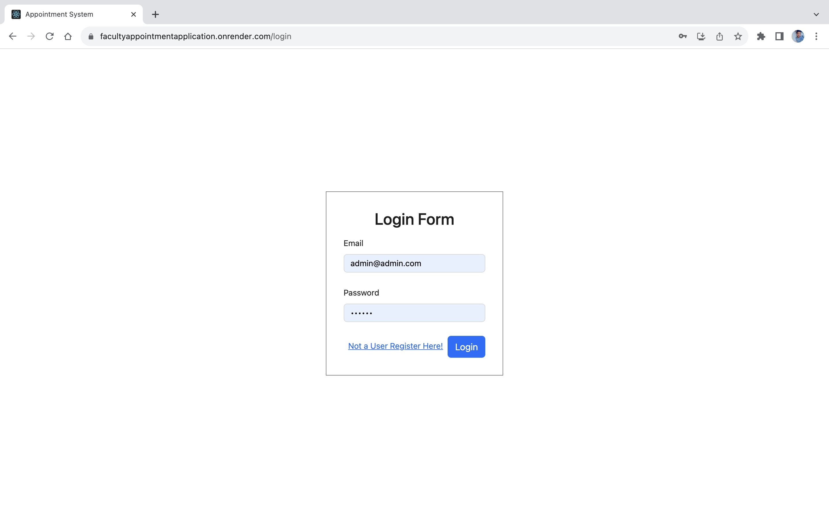
Snapshots
Login/Signup view:

Slide 11
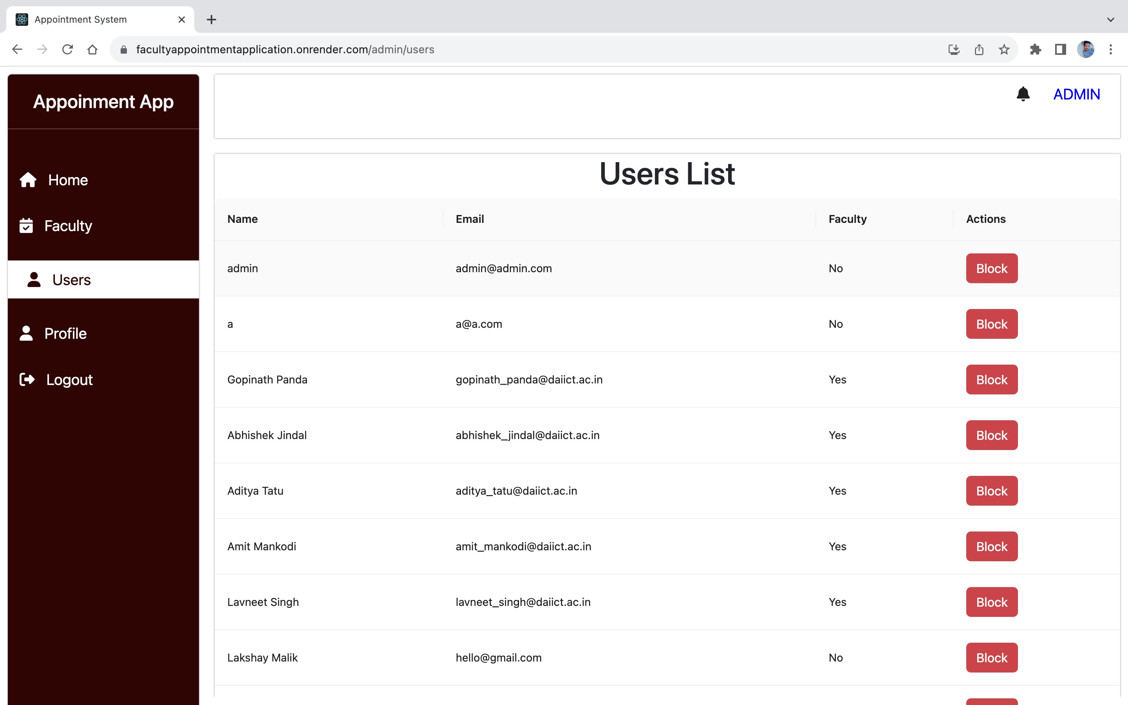
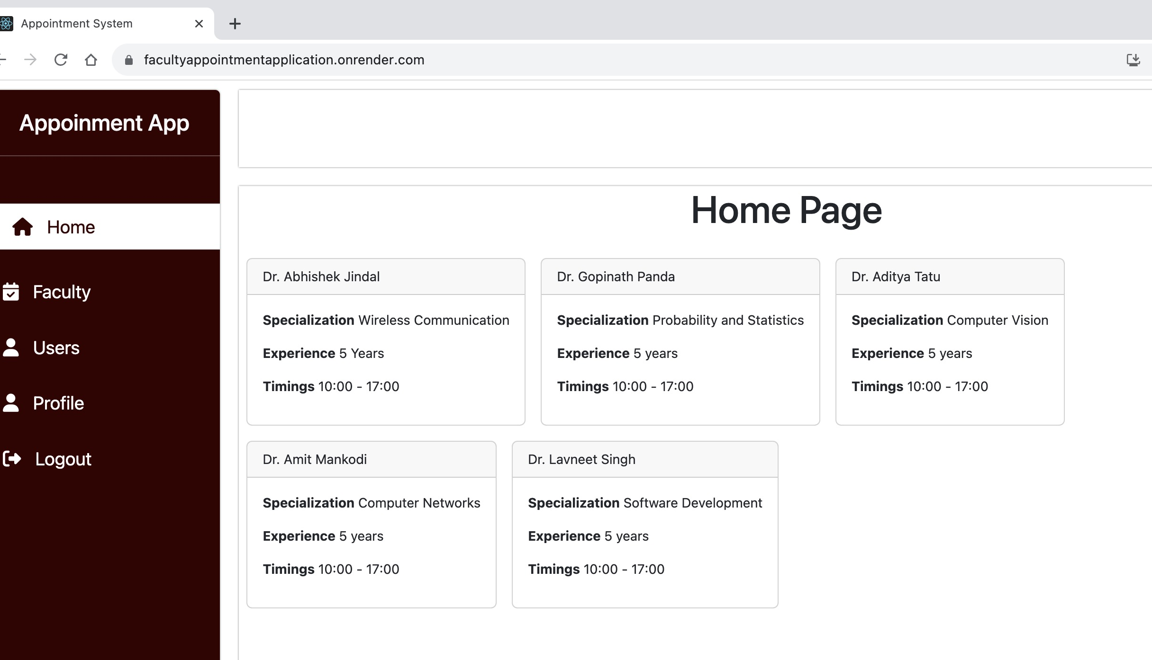
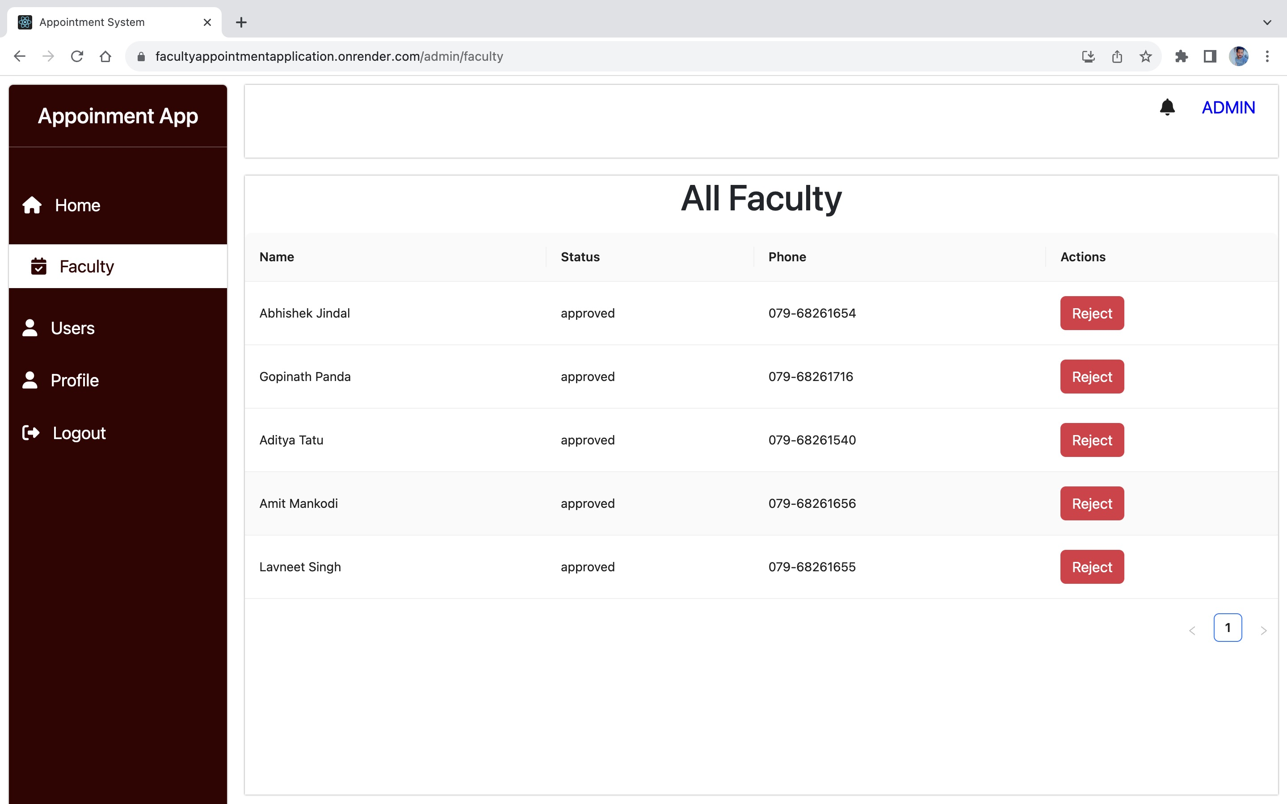
Admin View

Slide 12
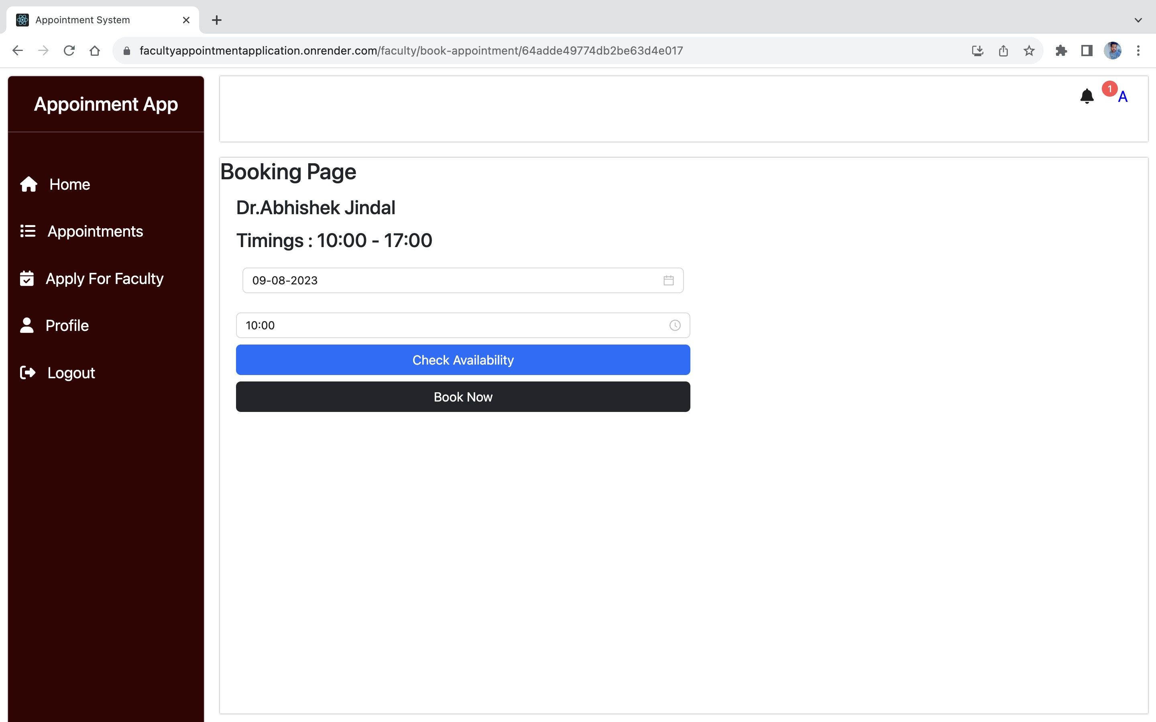
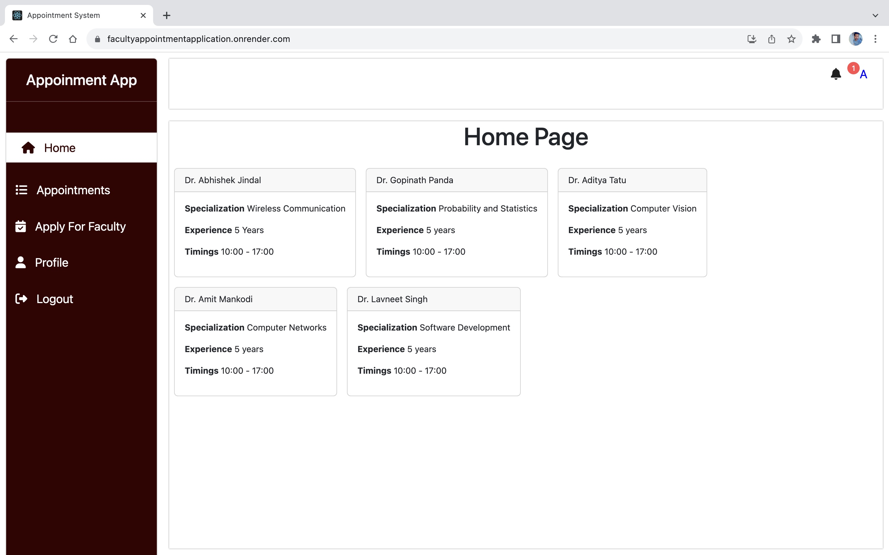
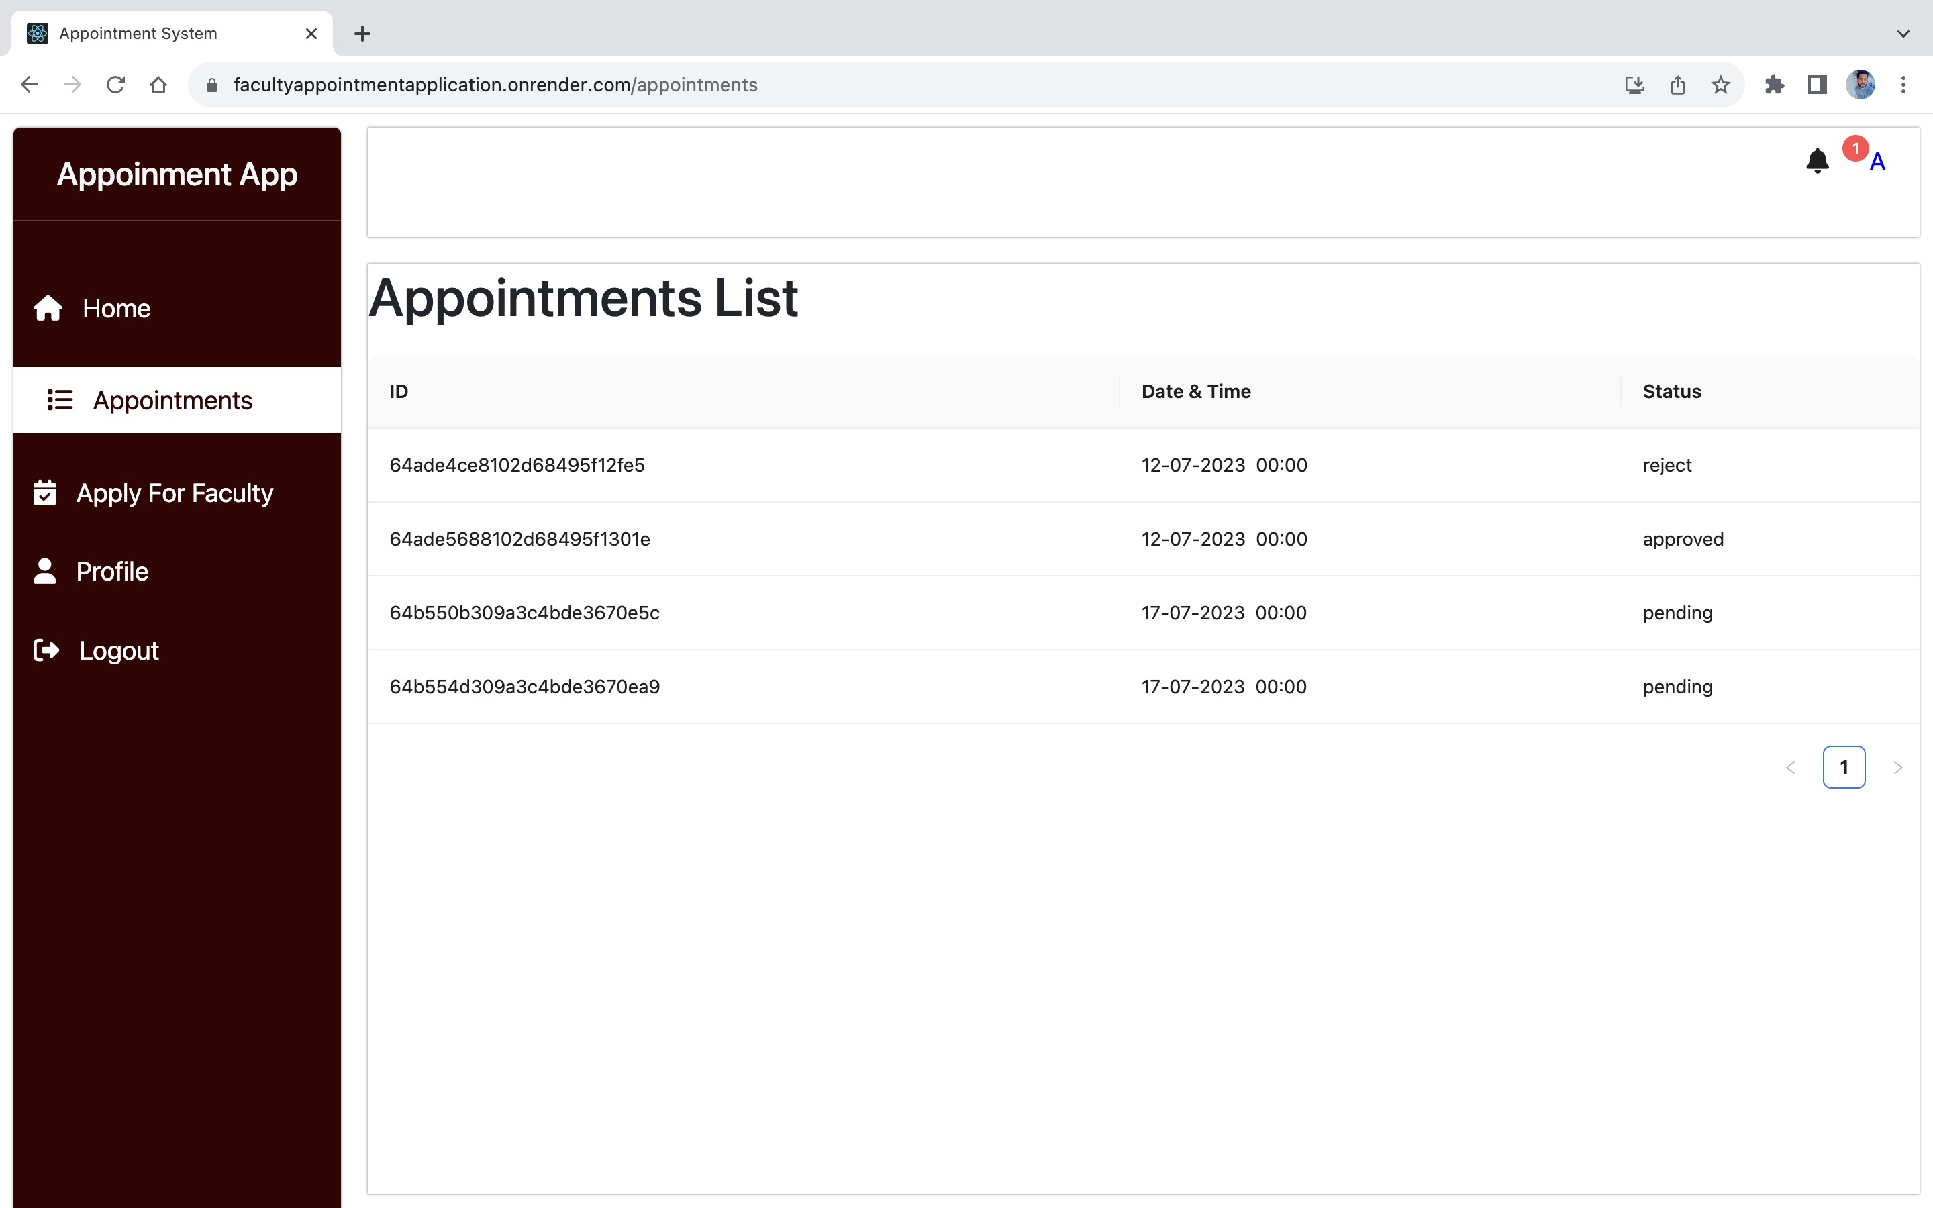
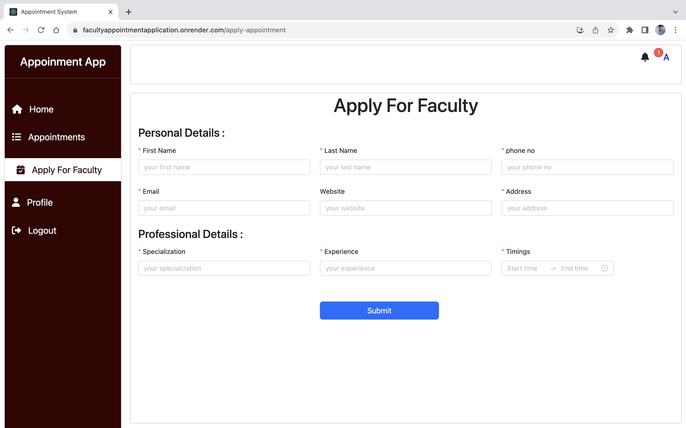
User/Student view

Slide 13
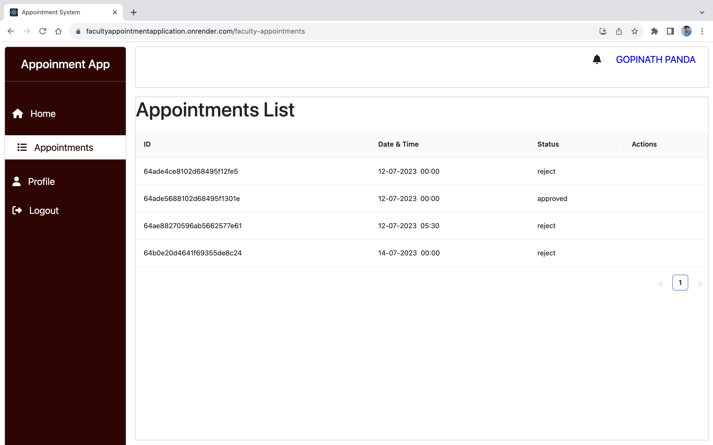
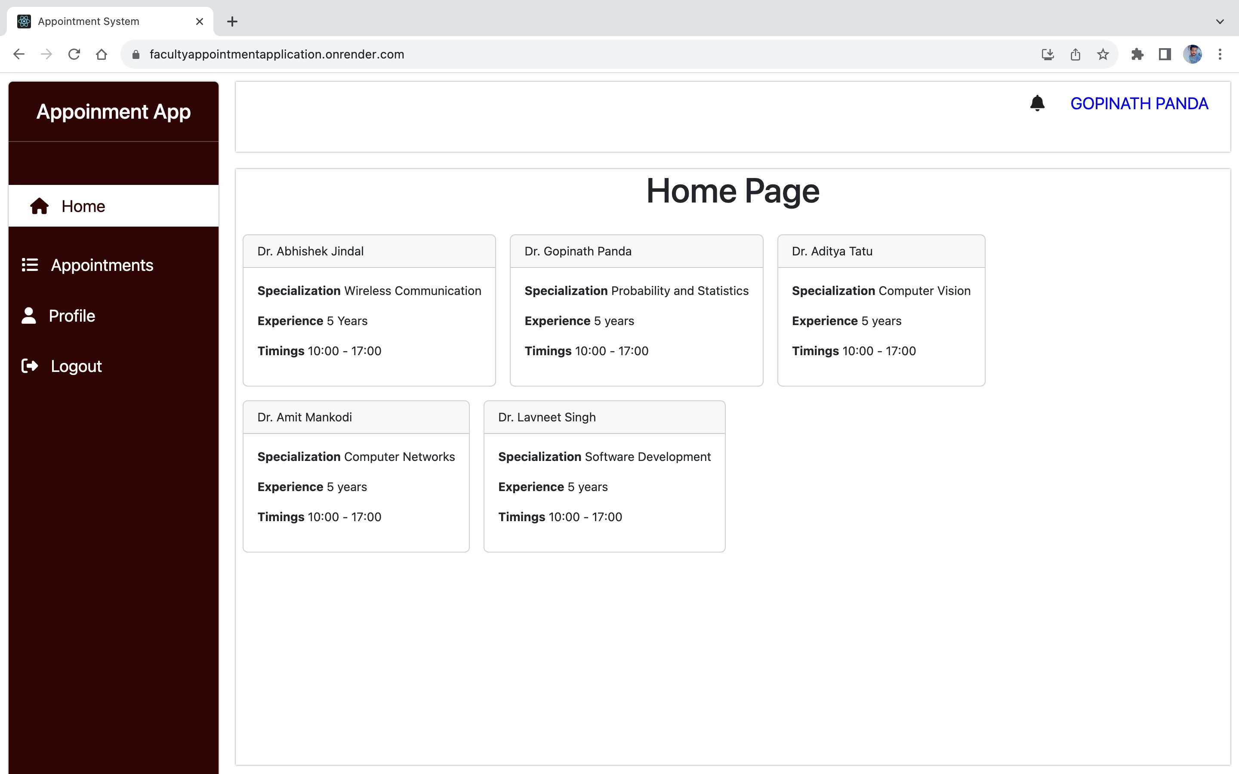
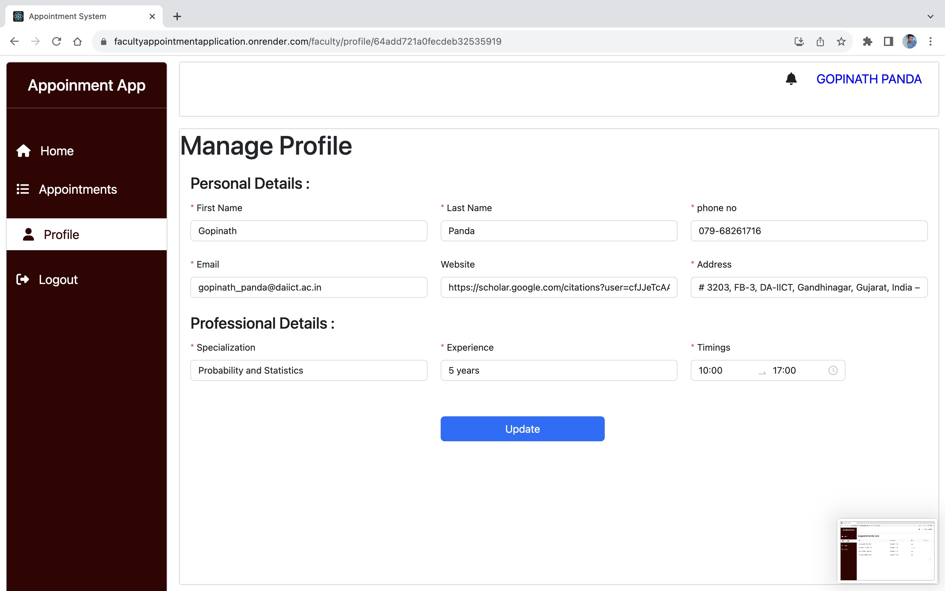
Faculty View

Slide 14
Conclusion
The Faculty Appointment System based on the MERN stack provides an efficient and user-friendly solution for scheduling appointments between students and faculty members. By leveraging modern web technologies and conducting thorough testing, the system aims to enhance the appointment management process, improving communication and productivity within an academic or professional institution.

